Slide 1
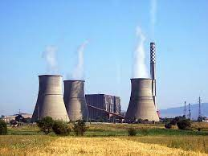
STEAM POWERPLANT

Slide 2
A steam power plant converts the chemical energy of the fossil fuel (Coal) into mechanical energy/electrical energy.
It is a power station which uses water as working fluid.
Components:
Boiler
Steam Turbine
Generator
Condenser
Feed Pump

Slide 3
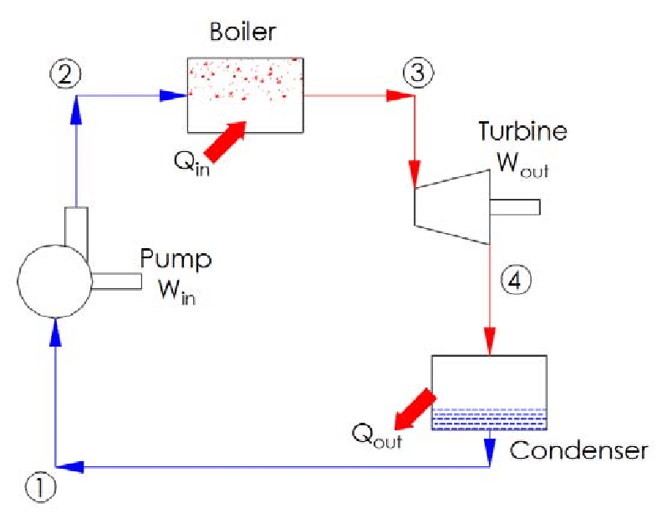

Slide 4
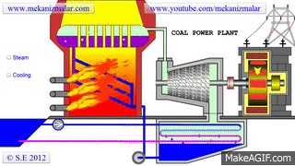
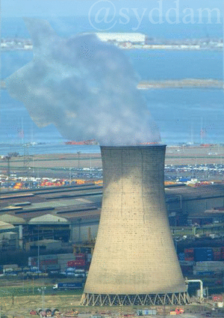
Cooling Tower
Working of steam power plant

Slide 5
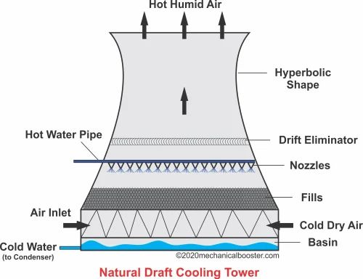

Slide 6
Boiler:
It converts the water into high pressure steam. It contains the furnace inside or outside the boiler shell. The combustion of coal takes place in the furnace.
Steam Turbine:
It is the mechanical device which converts the kinetic energy of the steam to the mechanical energy. The kinetic energy of the steam rotates the blades of the turbine.
Generator:
It is coupled with the turbine rotor and converts the mechanical energy of the turbine to the electrical energy.

Slide 7
4. Condenser:
It condensate the steam that leaves out turbine. It converts the low pressure steam to water. It is attached to the cooling tower.
5. Feed Pump:
It is used to feed the condensed water into the boiler.

Slide 8
Working:
In the steam power plant, the pulverized coal is fed into the boiler and it is burnt in the furnace. The water present in the boiler drum changes to high pressure steam.
From the boiler the high pressure steam passed to the turbine where it strikes the blades with high speed and the turbine starts rotating at high speed. A generator is attached to the rotor of the turbine converts the mechanical energy of the turbine into electrical energy.
After striking on the turbine the steam leaves the turbine and enters into the condenser. The steam gets condensed with the help of cold water from the cooling tower. The condensed water with the feed water enters into the boiler at high pressure and the cycle repeats.

Slide 9

ADVANTAGES
DISADVANTAGES
Low initial cost so economical.
Less land area is required compared to hydro plants
Cost of coal is cheaper than petrol and diesel fuel
Easy maintenance
Water sources are easily available.
High Running Cost
Low Efficiency
Global Warming
Adverse Effect on the aquatic living organism

Slide 10
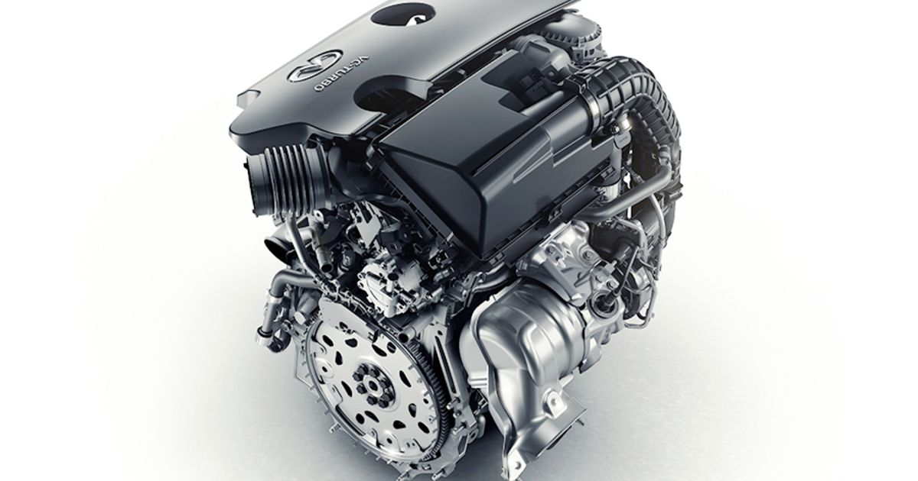
IC ENGINES

Slide 11
A machine or device which derives heat from the combustion of fuel and converts part of this energy into mechanical work is called a heat engine. Heat engines may be classified into two main classes as follows:
1. External combustion engines
2. Internal combustion engines.
External Combustion Engines – The engines in which combustion of fuel takes place outside the cylinder are external combustion engines.
E.g. Steam Engines, Powerplants
Internal Combustion Engines - In this case, combustion of fuel with oxygen of the air occurs within the cylinder of the engine.
E.g. Automotive engines

Slide 12
CLASSIFICATION OF IC ENGINES
1. According to the type of fuel used
a) Petrol engines b) Diesel engines c) Gas engines.
2. According to the method of igniting the fuel
a) Spark ignition engines b) Compression ignition engines.
3. According to the number of strokes per cycle
a) Four stroke cycle engines b) Two stroke cycle engines.
4. According to speed of engine
a) Low Speed Engines b) Medium Speed Engines c) High Speed Engines

Slide 13
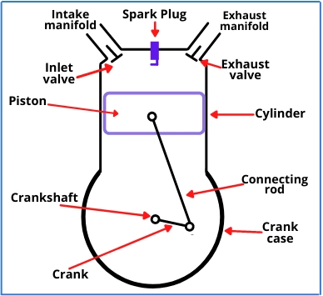
COMPONENTS OF IC ENGINE
Cylinder Block
Piston
Connecting Rod
Crankshaft
Crank
Inlet and Exhaust Valves
Inlet and Exhaust Manifold
Spark Plug or Injector

Slide 14
SEQUENCE OF OPERATION
1. Suction stroke – In this stroke, the fuel vapour in correct proportion enters to the engine cylinder.
2. Compression stroke –. In this stroke, the fuel vapour is compressed in the engine cylinder.
3. Expansion stroke – In this stroke, the fuel vapour is fired just before the compression is complete. It results in the sudden rise of pressure and pushes the piston with a great force downwards and rotates the crankshaft followed by drive of vehicle.
4. Exhaust stroke – In this stroke, the burnt gases (or combustion products) are exhausted from the engine cylinder, so as to make space available for the fresh fuel vapour.

Slide 15
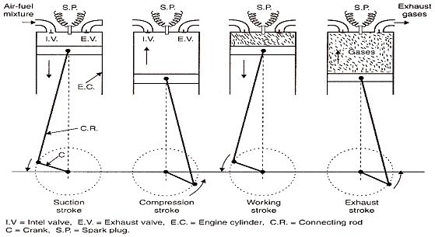
FOUR STROKE ENGINE

Slide 16
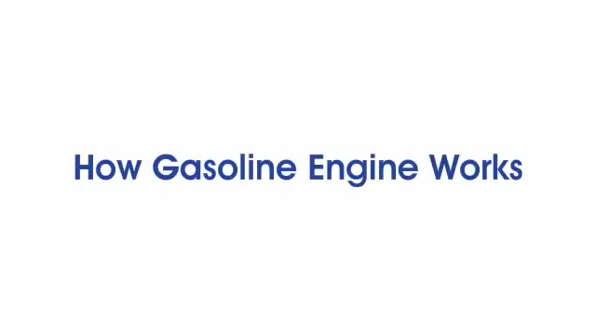
Petrol Engine Working Principle

Slide 17

Deisel Engine Working Principle

Slide 18
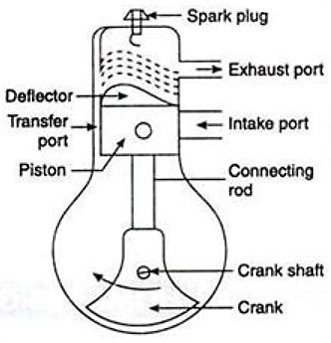
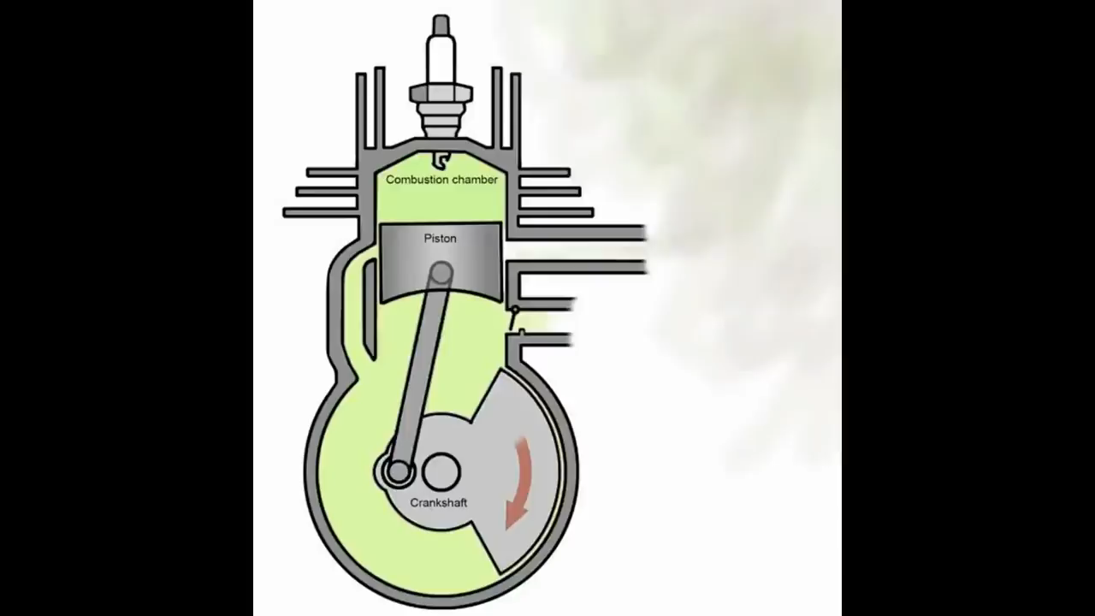
TWO STROKE ENGINE
UPWARD STROKE
DOWNWARD STROKE

Slide 19
In two stroke engine the suction and exhaust strokes are eliminated.
There are only two remaining strokes – these are the compression stroke and Expansion or power stroke and usually called as upward stroke and downward stroke.
Instead of valves, the two stroke engine consists of inlet and exhaust ports.
The fresh charge enters into the cylinder through inlet port and burnt gases escapes out through exhaust port.
The burnt exhaust gases are forced out through the exhaust port by fresh charge which enters the cylinder nearly at the end of the working stroke through the inlet port.

